Slide 1
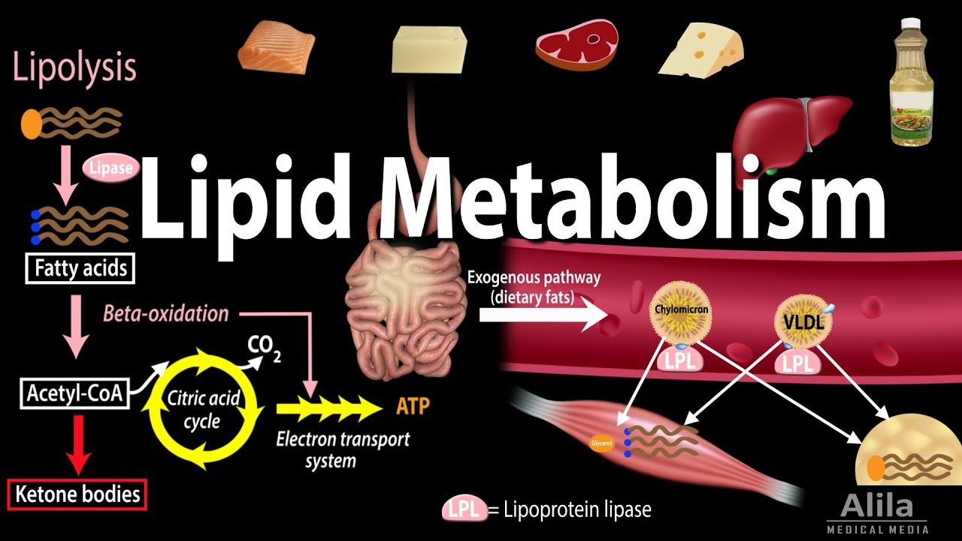
By: Dr. Kalpana Jorasia
Assistant Professor
(VPB)

Slide 2
Why should fat be the fuel reserve of the body?
Triacylglycerols are the most predominant storage form of energy.
1. Triacylglycerols (TG) are highly concentrated form of energy, yielding 9 Cal/g, in contrast to carbohydrates and proteins that produce only 4 Cal/g. This is because fatty acids found in TG are in the reduced form.
2. The triacylglycerols are non-polar and hydrophobic in nature, hence stored in pure form with out any association with water (anhydrous form). On the other hand, glycogen and proteins are polar. One gram of glycogen combines with 2 g of water for storage

Slide 3
Transport of Iipids
The insoluble lipids are solubilized in association with proteins to form lipoproteins in which form lipids are transported in the blood stream.
Free lipids are undetectable in blood.
Chylomicrons, very low density lipoproteins(VLDL), low density lipoproteins (LDL), high density lipoproteins (HDL) and albumin-free fatty.
Transport of free fatty acids(FFAs):
FFAs are also called as non-esterified(NEFAs) or unesterified fatty acids (UFAs) fatty acids. In plasma, long chain FFAs are bound to albumin and in cells they are attached to fatty acid binding protein.

Slide 4
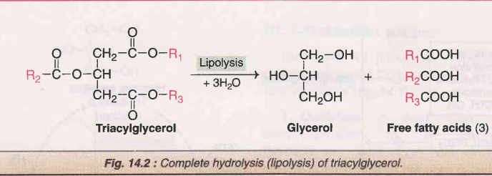
Mobilization of fat from adipose tissues
Degradation of triacylglycerol in adipocytes is triggered by activation of hormone sensitive lipase a.
The lipase catalyzes hydrolysis of triacylglycerol to produce one molecule of glycerol and three molecules of fatty acid.
The complete degradation of triacylglycerol to glycerol and free acids is known as lipolysis.

Slide 5
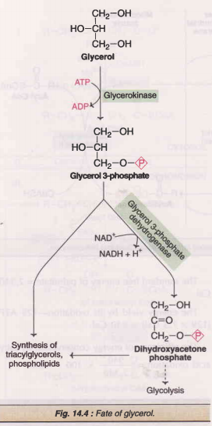
Fate of glycerol
The adipose tissue lacks the enzyme glycerol kinase, hence glycerol produced in lipolysis cannot be phosporylated here. lt is transported to liver where it is activated to glycerol 3-phosphate. The latter may be used for the synthesis of triacylglycerols and phospholipids. Glycerol 3-phosphate may also enter glycolysis by getting converted to dihydroxyacetone phosphate .

Slide 6
Fate of free fatty acids
The fatty acids released by lipolysis in the adipocytes enter the circulation and are transported in a bound form to albumin.
The free fatty acids enter various tissues and are utilized for the energy. About 95% of the energy obtained from fat comes from the oxidation of fatty acids. Certain tissues, however, cannot oxidize fatty acids, e.g. brain, erythrocytes.
The process of lipolysis of TG and reesterification of FFA to TG is termed as triacylglycerol/fatty acid cycle.

Slide 7
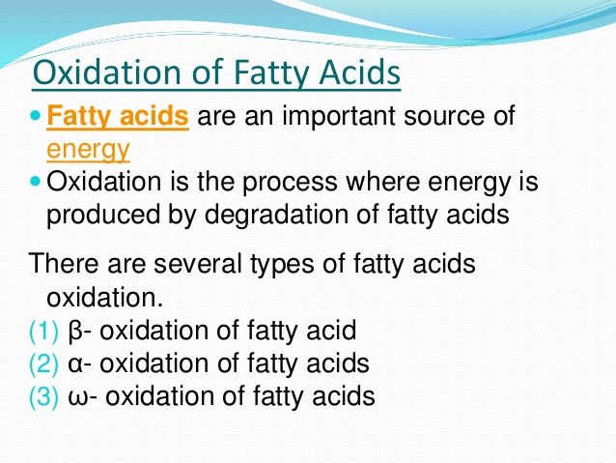

Slide 8
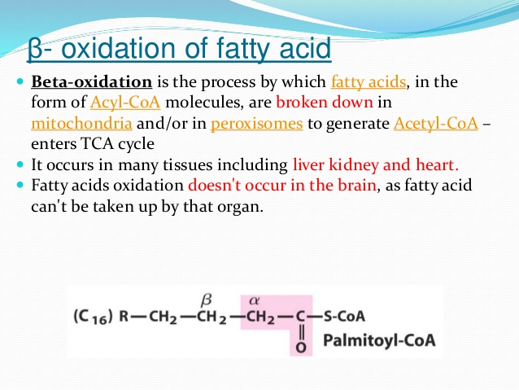
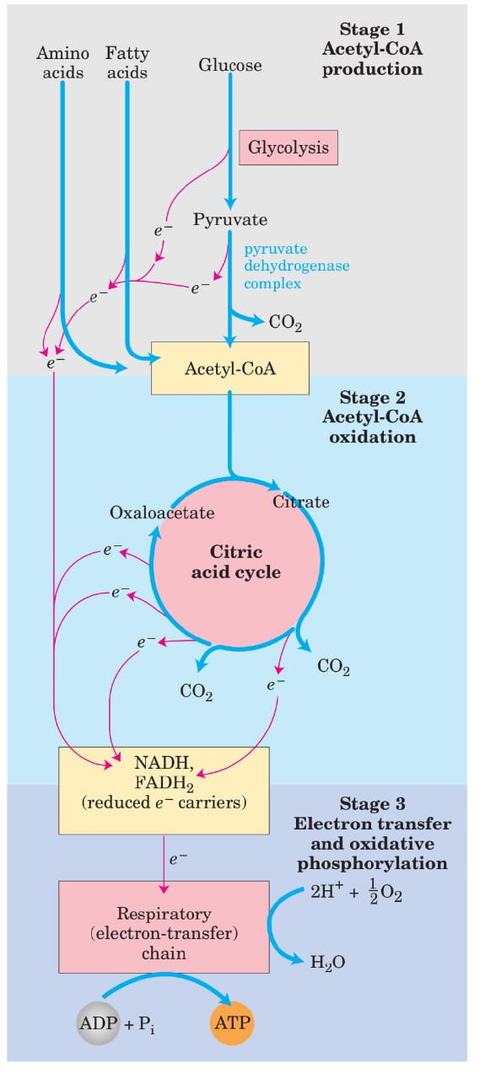
Brain, erythrocytes and adrenal medulla cannot utilize fatty acids for energy requirement

Slide 9
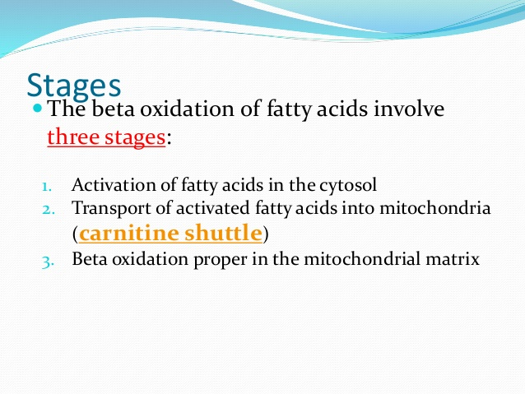
Beta-Oxidation may be defined as the oxidation of fatty acids on the beta-carbon atom. This results in the sequential removal of a two carbon fragment, acetyl CoA.

Slide 10
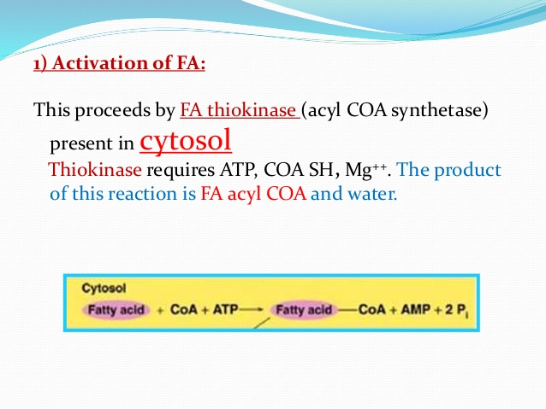
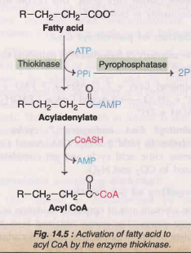
In the activation of FFA, two high energy phosphates are utilized.

Slide 11
2.Transfer of activated fatty acids into the mitochondrial matrix
Short chain fatty acids could cross the inner mitochondrial membrane easily, without the help of any transporter.
Long chain fatty acids or their acyl-CoA form cannot cross the inner mitochondrial membrane.
They are transported across the membrane with the help of a transporter called “carnitine transporter” ( β -hydroxy- γ -trimethyl ammonium butyrate.
The cell has two separate pools (cytosolic and mitochondrial) of coenzyme A.
Inhibitor of carnitine shuttle : Carnitine acyltransferase I is inhibited by malonyl CoA, a key metabolite involved in fatty acid synthesis that occurs in cytosol.

Slide 12
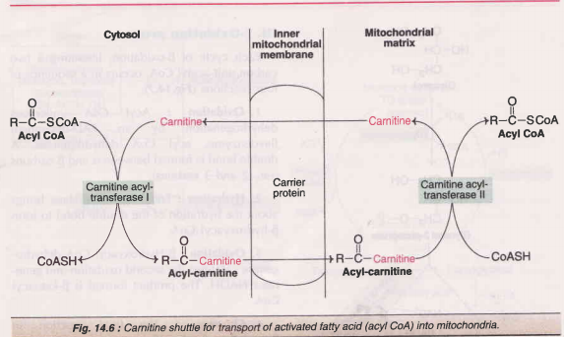

Slide 13
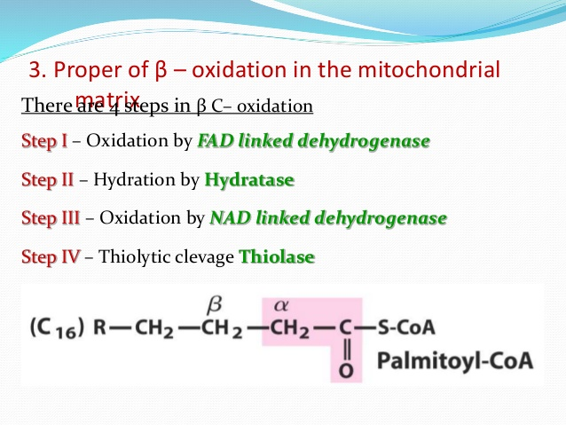

Slide 14
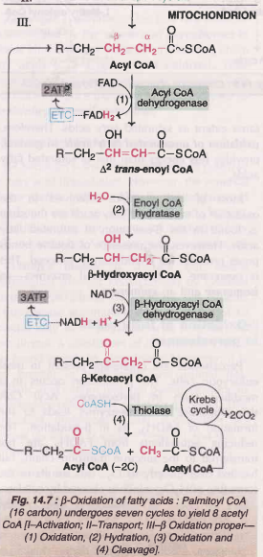
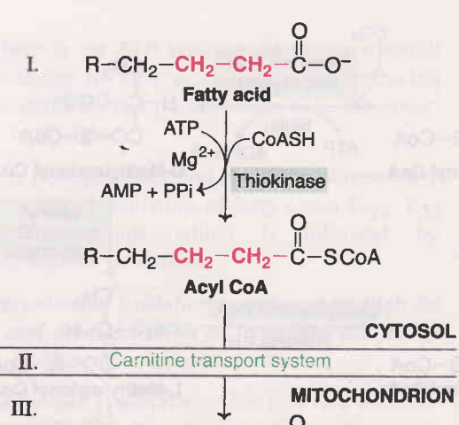

Slide 15
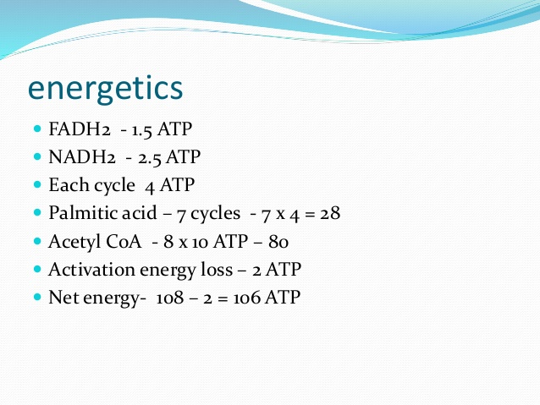
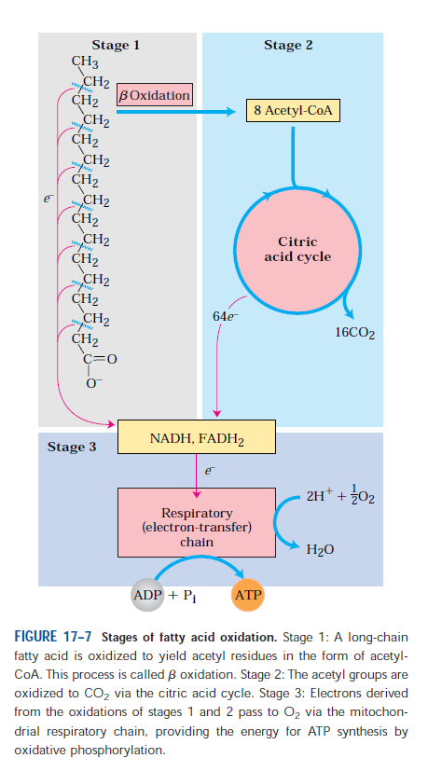
Palmitoyl CoA undergoes 7 cycles of beta-oxidation to yield 8 acetyl CoA.

Slide 16
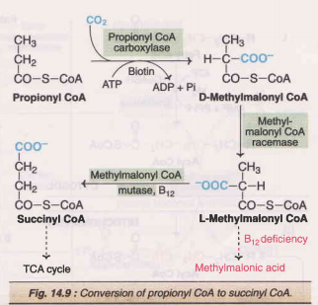
Oxidation of odd carbon chain fatty acids
Oxidation of fatty acids with an odd number of carbon atoms produces acetyl CoA and one molecule of Propionyl – Co A as final products.
This Propionyl-Co A is converted into Succinyl-Co A and enters TCA cycle, which can be oxidised or utilized for gluconeogenesis.
Propionyl CoA is carboxylated in the presence of ATP, CO2 and vitamin biotin to D-methylmalonyl CoA.
Methylmalonyl CoA mutase, is dependent on vitamin B₁₂ (deoxyadenosyl cobalamin)

Slide 17
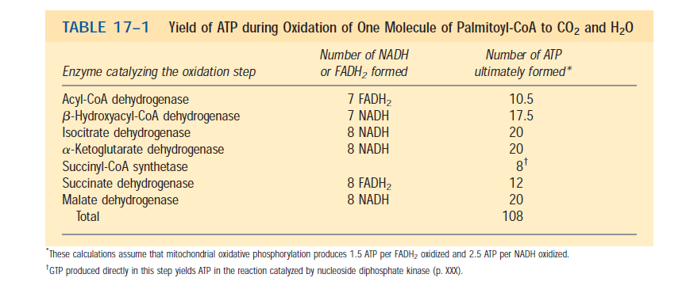

Slide 18
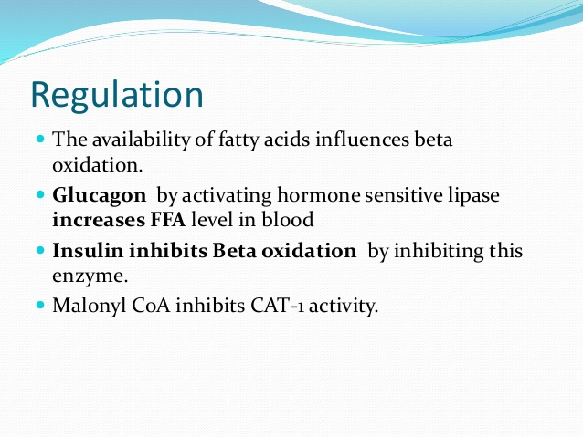

Slide 19
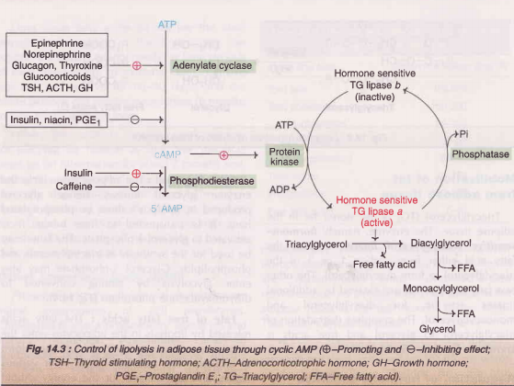

Slide 20
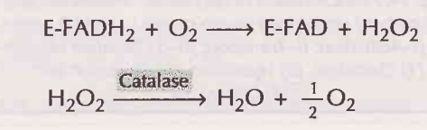
Beta-Oxidation of fatty acids in peroxisomes
Peroxisomes are organelles present in most eukaryotic cells. The beta-oxidation occurs in a modified form in peroxisomes. Acyl CoA dehydrogenase (a flavoenzyme) leads to the formation of FADH2, as in beta-oxidation.
The reducing equivalents from FADH2 are not transferred to the electron transport chain, but handed over directly to 0_{2.} This results in the formation of H₂O₂, which is cleaved by catalase.
There is no ATP synthesized in peroxisomal beta-oxidation of fatty acids, since the reducing equivalents do not pass through ETC. However, heat is liberated.
Peroxisomal oxidation is induced by high fat diet and administration of hypolipidemic drugs

Slide 21
OTHER TYPES OF OXIDATION OF FATTY ACIDS
1. α-oxidation occurs in brain especially in the endoplasmic reticulum. This is involved in the metabolism of methylated fatty acids. First hydroxylation occurs at α - carbon followed by oxidation and decarboxylation releasing CO₂ from the carboxyl terminus, providing the substrate that can be metabolized through ß -oxidation. This type of oxidation does not generate high-energy compounds.
2. ω-oxidation occurs in endoplasmic reticulum, which involves hydroxylation and oxidation at the terminal methyl group of fatty acids to form a dicarboxylic acid, which undergoes ß - oxidation; this type of oxidation occurs in peroxisome also. The end product may be excreted in the urine.
3. Oxidation of unsaturated fatty acids requires two additional enzymes
Enoyl-CoA isomerase, which converts cis-isomer to a trans-isomer
2, 4–dienoyl-CoA reductase, which is involved in the addition of hydrogen atoms across the double bonds.

Slide 22
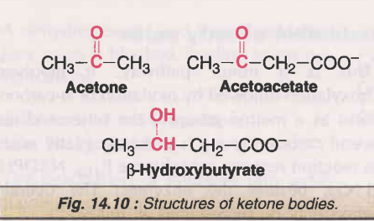
KETONE BODIES
The compounds namely acetone, acetoacetate and β-hydroxybutyrate (or 3-hydroxy butyrate)are known as ketone bodies
Acetone, acetoacetate-two are true ketones
β-hydroxybutyrate does not possess a keto (C=O) group.
Ketone bodies are water-soluble and energy yielding.
Acetone( volatile waste product which can be excreted via lungs), however, is an exception, since it cannot be metabolized

Slide 23
Ketogenesis ( Liver, mitochondrial matrix)
The synthesis of ketone bodies occurs in the Iiver.
The enzymes for ketone body synthesis are located in the mitochondrial matrix
Acetyl CoA, formed by oxidation of fatty acids, pyruvate or some amino acids, is the precursor for ketone bodies.
HMG CoA synthase, catalysing this reaction, regulates the synthesis of ketone bodies.
β-hydroxybutyrate is the most predominant ketone body present in circulation and urine in ketosis

Slide 24
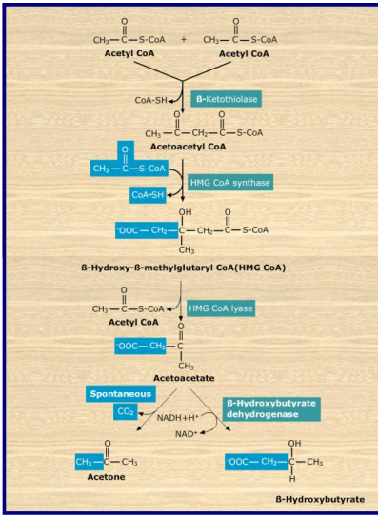
Ketogenesis

Slide 25
Oxidation/ utilization of ketone bodies
The liver lacks the enzyme called “thiophorase ( Succinyl-CoA: acetoacetyl-CoA transferase) and therefore cannot use the ketone bodies as fuel.
As ketone bodies are soluble in water, they could be transported through blood without the involvement of any transporters.
Erythrocytes (RBC) -cannot utilize ketone due to lack of mitochondria which lack mitochondria.
Excess amount of ketone bodies are produced in starvation and diabetes mellitus.
During prolonged starvation, ketone bodies are the major fuel source for the brain.
The ketone bodies can meet 50-70% of the brain's energy needs.
In non-ruminants, liver is the sole source of ketone body production. In ruminants, rumen epithelium and mammary glands are also the sources of ketone bodies.

Slide 26
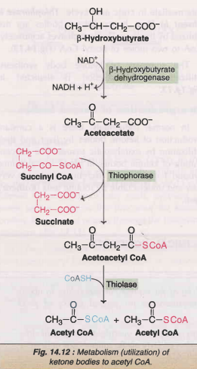

Slide 27
Overproduction of ketone bodies
The presence of excessive amount of ketone bodies in blood is called as “ketonemia”, and it results in the appearance of ketone bodies in urine called as ““ketonuria” and in milk (ketolactia).
Ketonemia and ketonuria is commonly referred to as ketosis.
Smell of acetone in breath is a common feature in ketosis
For detection of ketone bodies in urine-----Rothera's test.
Excess ketone bodies in the blood, decreases blood pH, resulting in “ketoacidosis”.
As ketone bodies complex with Na+ and K+, urinary loss of ketone bodies result in loss of electrolytes and polyuria.

Slide 28
In starvation, oxaloacetate is drawn out of the citric acid cycle for the synthesis of glucose, thereby decreasing the availability of oxaloacetate, resulting in the accumulation of acetyl-Co A favouring the overproduction of ketone bodies.
In diabetes mellitus, due to the deficiency of insulin, the available glucose is not transported to cells of skeletal muscles and adipocytes. So, to obtain energy, the cell depends on the β-oxidation of fatty acids, resulting in the overproduction of acetyl-CoA, leading to the synthesis of ketone bodies.

Slide 29
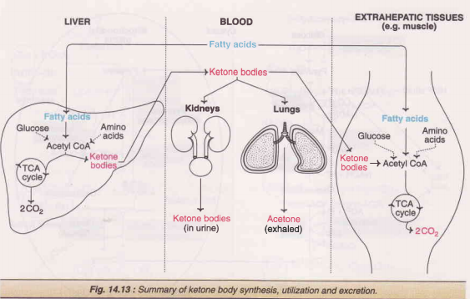

Slide 30
FATTY ACID BIOSYNTHESIS
The synthesis takes place in cytosol.
Fatty acids are synthesized when there is excess nutrient availability (glucose). These will be esterified with glycerol and stored as triacylglycerol or the fatty acids will also used for the synthesis of phospholipids to form cell membrane.
Fatty acid synthesis occurs mainly in the liver and adipocytes and to a lesser extent in mammary gland during lactation.
Acetyl CoA and NADPH are the two important prerequisites for fatty acid synthesis along with ATP.
The HMP shunt is the major source of NADPH. The other source is by the action of malic enzyme.

Slide 31
The overall synthesis can be divided into 3 steps
Production of acetyl CoA and NADPH
Formation of malonyl CoA from acetyl CoA
Reactions of Fatty acid synthase complex

Slide 32
1. PRODUCTION OF ACETYL CoA AND NADPH
Acetyl CoA and NADPH are the prerequisites for fatty acid synthesis. Acetyl CoA is produced in the mitochondria by the oxidation of pyruvate and fatty acids, degradation of carbon skeleton of certain amino acids, and from ketone bodies.
Mitochondria, however, are not permeable to acetyl CoA.
An alternate or a bypass arrangement is made for the transfer of acetyl CoA to cytosol.
Acetyl CoA condenses with oxaloacetate in mitochondria to form citrate.
Citrate is freely transported to cytosol where it is cleaved by citrate lyase to liberate acetyl CoA and oxaloacetate. Oxaloacetate in the cytosol is converted to malate.
Malic enzyme converts malate to pyruvate. NADPH and CO₂ are generated in this reaction. Both of them are utilized for fatty acid synthesis.

Slide 33
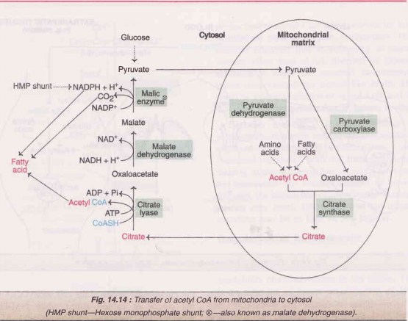

Slide 34
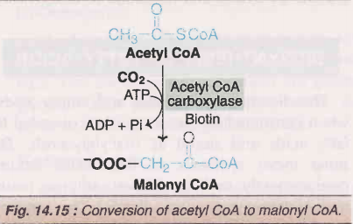
2.FORMATION OF MALONYL CoA FROM ACETYL CoA
The acetyl-CoA is carboxylated to form malonyl-CoA, catalyzed by acetyl-CoA carboxylase, a biotin dependent enzyme. This enzyme is the regulatory enzyme in the synthesis of fatty acids.
Regulatory enzyme in the synthesis of fatty acids: acetyl-CoA carboxylase

Slide 35
3. REACTION OF FATTY ACID SYNTHASE COMPLEX
(Fatty acid complex) FAS COMPLEX
The remaining reactions of fatty acid synthesis are catalyzed by a multifunctional enzyme known as fatty acid synthase (FAS) complex.
Fatty acid synthase (FAS) is a multienzyme complex possessing 7 different enzyme activities.
The fatty acid synthase of mammals is a dimer composed of two identical subunits. The complex has two thiol groups.
1. –SH group of cysteine residue
2. –SH group of ACP (acyl carrier protein) containing 4-phosphopantetheine.

Slide 36
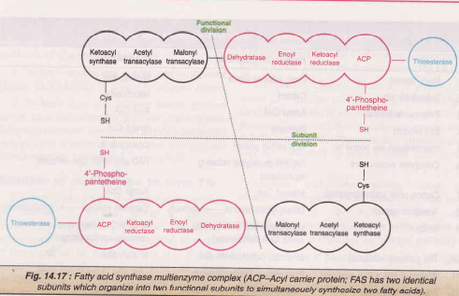
Fatty acid complex (FAS)

Slide 37
1. The two carbon fragment of acetyl CoA is transferred to ACP of fatty acid synthase, catalysed by the enzyme, acetyl CoA-ACP transacylase.
The acetyl unit is then transferred from ACP to cysteine residue of the enzyme.
Thus ACP site falls vacant.
2. The enzyme malonyl CoA-ACP transacylase transfers malonate from malonyl CoA to bind to ACP.
3. The acetyl unit attached to cysteine is transferred to malonyl group (bound to ACP). The malonyl moiety loses CO₂ which was added by acetyl CoA carboxylase. Thus, CO₂ is never incorporated into fatty acid carbon chain. The decarboxylation is accompanied by loss of free energy which allows the reaction to proceed forward. This reaction is catalyzed by β-ketoacyl ACP synthase

Slide 38
4. β- Ketoacyl ACP reductase reduces ketoacyl group to hydroxyacyl group. The reducing equivalents are supplied by NADPH.
5. β-Hydroxyacyl ACP undergoes dehydration. A molecule of water is eliminated and a double bond is introduced between α and β carbons.
6. A second NADPH-dependent reduction, catalysed by enoyl-ACP reductase occurs to produce acyl-ACP. The four-carbon unit attached to ACP is butyryl group.
The reduction, dehydration and reduction are repeated until the chain is 16 carbon in length. At this point hydrolysis ( palmitoyl thioestrase) occurs and the palmitate is released.
Note: The two functional subunits of FAS independently operate and synthesize two fatty acids simultaneous

Slide 39
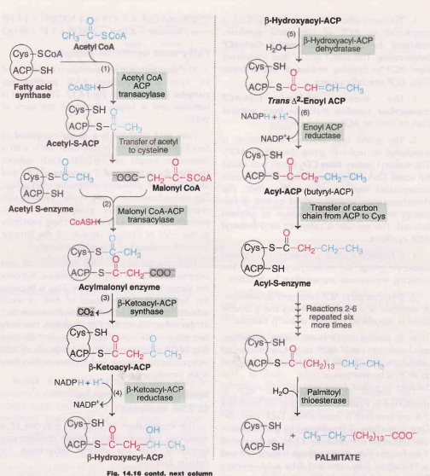

Slide 40
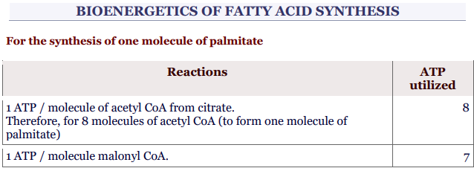
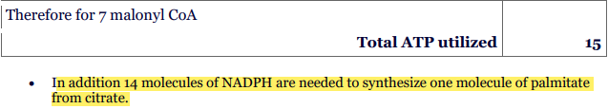

Slide 41
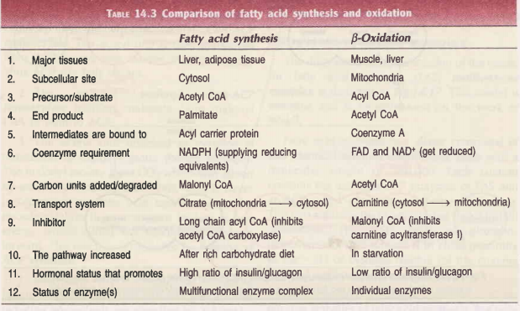

Slide 42
Regulation of fatty acid synthesis
Acetyl CoA carboxylase : This enzyme controls a committed step in fatty acid synthesis.
Hormonal influence : Insulin promotes fatty acid synthesis
glucagon inhibits.
Dietary regulation:
1) high carbohydrate or fat-free diet increases the synthesis of acetyl CoA carboxylase and fatty acid synthase, which promote fatty acid formation.
2) fasting or high fat diet decreases fatty acid production by reducing the synthesis of acetyl CoA carboxylase and fatty acid synthase (FAS).
Availability of NADPH: About 50-60% of required NADPH is obtained
from HMP shunt, which significantly influences fatty acid synthesis

Slide 43
Desaturation of fatty acid chains
A microsomal enzyme system called fatty acyl CoA desaturase is responsible for the formation of unsaturated fatty acids.
SYNTHESIS (Elongation) OF LONG CHAIN FATTY ACIDS FROM PALMITATE
The end product of the fatty acid synthesis is palmitic acid.
In cells fatty acids having chain length of C18, C20,C22 and C24 are commonly seen.
The synthesis of these fatty acids occurs mainly in the endoplasmic reticulum using
malonyl CoA and NADPH.
The palmitate participates as CoA derivative instead of fatty acyl ACP

Slide 44
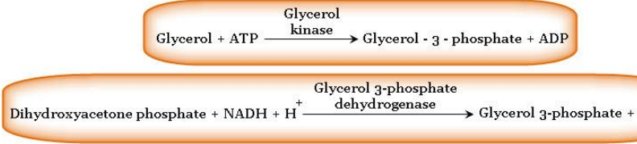
BIOSYNTHESIS OF TRIACYLGLYCEROL
Synthesis of TAG occurs in adipose tissue and liver.
Smooth endoplasmic reticulum is the site of synthesis.
Fatty acids and glycerol must be activated prior to the synthesis of triacylglycerols. Conversion of fatty acids to acyl CoA by thiokinase is already describe (see Fig.14.6).
Synthesis of glycerol 3-phosphate (Liver) In both liver and adipose tissue, glucose serves as a precursor for glycerol 3-phosphate.
Dihydroxyacetone phosphate (DHAP) produced in glycolysis is reduced by glycerol 3-phosphate dehydrogenase to glycerol 3-phosphate

Slide 45
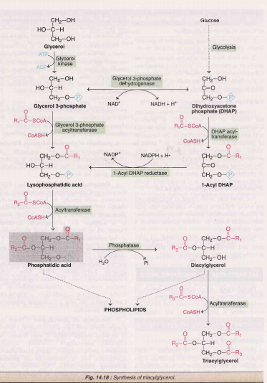

Slide 46
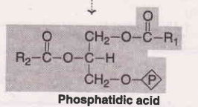
BIOSYNTHESIS OF PHOSPHOLIPIDS
Phosphatidic acid is the precursor for the synthesis of various phospholipids.
The compound that may bind to the phosphoric acid group of phosphatidic acid may be choline, ethanolamine, serine, inositol, or glycerol, resulting in different phospholipids.
Generally the fatty acid at C 1 is saturated and that at C 2 is unsaturated

Slide 47
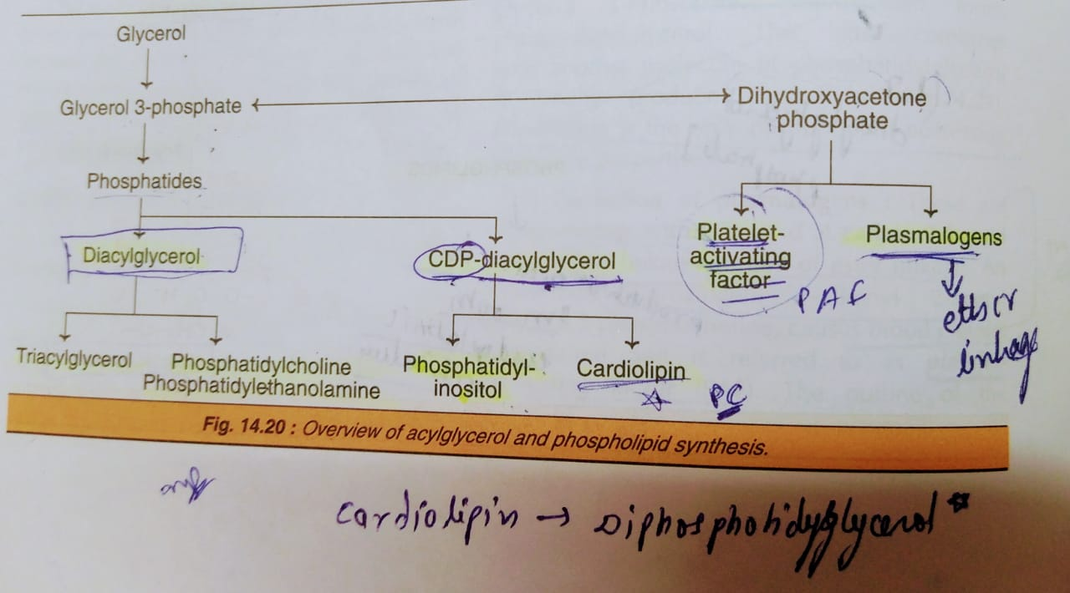
PFA (platelet activating factor) is also known as 1-Alkenyl 2-acetylglycerol 3-phosphocholine

Slide 48
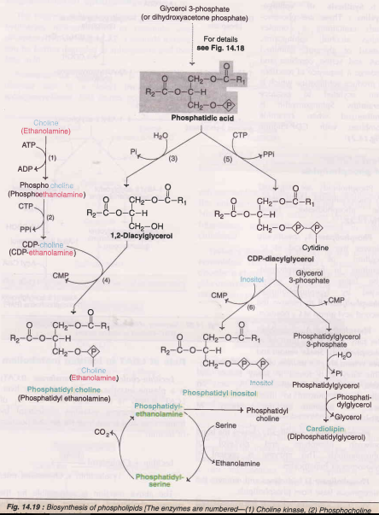
In mammals, phosphatidyl serine is not synthesized from CDP-diacyl glycerol, instead it is derived from phosphatidyl ethanolamine via the head-group exchange reaction

Slide 49
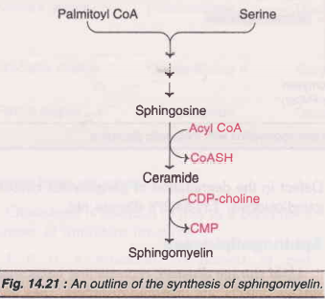
Synthesis of sphingomyelins : These are phospholipids containing a complex amino alcohol, sphingosine, instead of glycerol. Palmitoyl CoA and serine combine and undergo a sequence of reactions to produce sphingosine which is then acylated to produce ceramide. Sphingomyelin is synthesized when ceramide combines with CDP-choline.

Slide 50
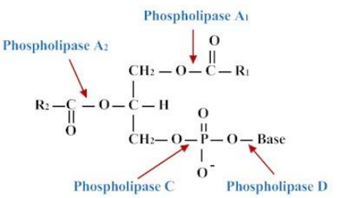
Degradation of phospholipids/Action of phospholipase
Phospholipase A₁ removes the acyl group from carbon 1 of phospholipid.
Phospholipase A₂ also releases acyl group from carbon 2 of phospholipid.
Phospholipase B acts on the lysophospholipid, after the action of A2.
Phospholipase C liberates diacylglycerol from phospholipids.
Phospholipase D produces phosphatidic acid from various phospholipids

Slide 51
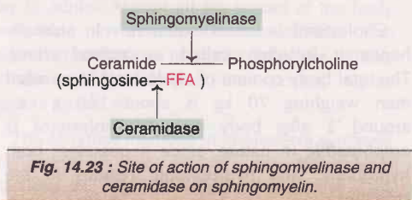
Degradation of sphingomyelins
The enzyme sphingomyelinase of lysosomes hydrolyses sphingomyelins to ceramide and phosphoryIcholine.
Ceramide formed further degraded to sphingosine and free fatty acid by ceramidase.

Slide 52
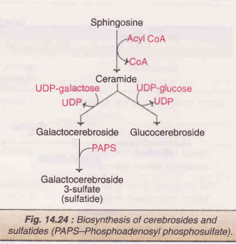
Metabolism of Glycolipids
Glycolipids are derivatives of ceramide (sphingosine bound to fatty acid), and they are known as glycosphingolipids.
The simplest form of glycosphingolipids are cerebrosides (ceramide + monosaccharides).
Galactocerebroside (Gal-Cer) and glucocerebroside (Glu-Cer) are the common glycosphingolipids.

Slide 53
Lipid storage disease/Sphinogolipidoses
Lipid storage diseases, representing IysosomaI storage defects, are inherited disorders. They are characterized by the accumulation of complex lipids.
The term sphingolipidoses is often used to collectively refer to the genetic disorders that lead to the accumulation of any one of the sphingolipids (glycosphingolipids and sphingomyelins).

Slide 54
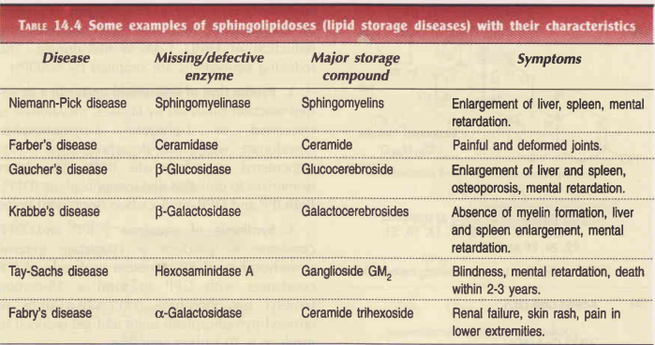
Lipid storage diseases

Slide 55
CHOLESTEROL BIOSYNTHESIS
Almost all the tissues of the body participate in cholesterol biosynthesis. The largest contribution is made by liver (50%), intestine (15%), skin, adrenal cortex, reproductive tissue etc.
The enzymes involved in cholesterol synthesis are found in the cytosol and microsomal fractions of the cell.
Acetate of acetyl CoA provides all the carbon atoms in cholesterol.
The reducing equivalents are supplied by NADPH while ATP provides energy.

Slide 56
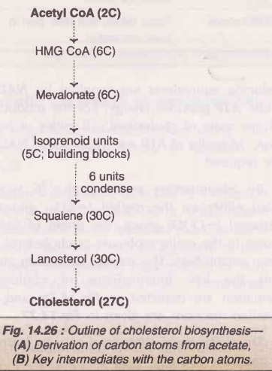
The synthesis of cholesterol (5 stages)
1. Synthesis of HMG CoA
2. Formation of mevalonate (6C)
3. Production of isoprenoid units (5C)
4. Synthesis of squalene (30C)
5. Conversion of squalene to cholesterol (27C)
HMG CoA reductase is the rate limiting enzyme in cholesterol biosynthesis

Slide 57
The penultimate product is 7-dehydrocholesterol which, on reduction, finally yields cholesterol.
Cholesterol biosynthesis is now believed to be a part of a major metabolic pathway concerned with the synthesis of several other isoprenoid compounds. These include
-ubiquinone (coenzyme Q of electron transport chain)
-dolichol (found in glycoprotein).
Both of them are derived from farnesyl pyrophosphate.

Slide 58
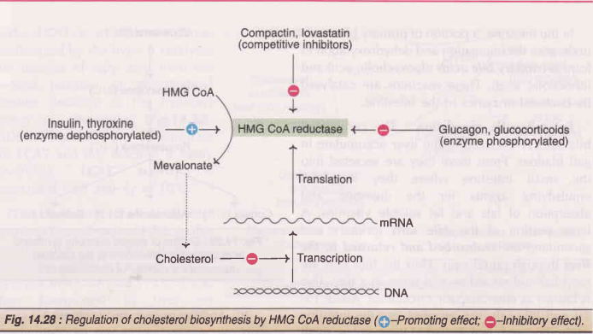
Regulation of cholesterol biosynthesis (by HMG CoA reductase)

Slide 59
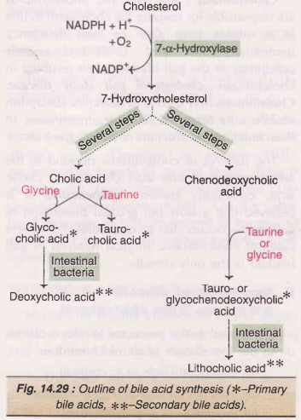
DEGRADATION OF CHOLESTEROL
1. Synthesis of bile acids:
The synthesis of primary bile acids (Cholic acid and chenodeoxycholic acid) takes place in the liver.
The step catalysed by 7 a-hydroxylase is inhibited by bile acids and this is the rate Iimiting reaction.
In the intestine, a portion of primary bile acids undergoes deconjugation and dehydroxylation to form secondary bile acids (deoxycholic acid and lithocholic acid)

Slide 60
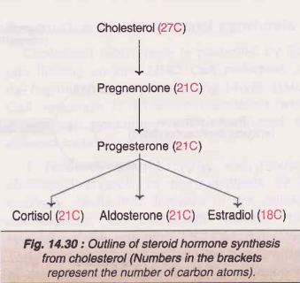
Fecal excretion of bile salts is the only route for the removal of cholesterol from the hody.
Cholelithiasis-cholesterol gall stone disease.
2. Synthesis of steroid from cholesterol
Cholesterol is the precursor for the synthesis of all the five classes of steroid hormones
(a) Glucocorticoids (e.g. cortisol)
(b) Mineralocorticoids (e.g. aldosterone)
(c) Progestins (e.g. progesterone
(d) Androgens (e.g. testosterone)
(e) Estrogens (e.g. estradiol).

Slide 61
3. Synthesis of vitamin D
7-Dehydrocholesterol, an intermediate in the synthesis of cholesterol, is converted to cholecalciferol (vitamin D₃) UV ultraviolet rays in the skin.
Hypercholesterolemia
Increase in plasma cholesterol (> 200 mg/dl) concentration is known as hypercholesterolemia and is observed in many disorders:
Diabetes mellitus
Hypothyroidism ( myxoedema)
Obstructive Jaundice
Nephrotic syndrome

Slide 62
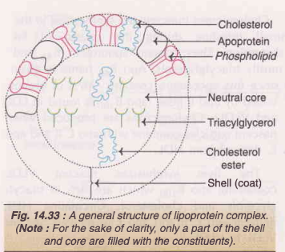
Lipoproteins
Lipoproteins are molecular complexes that consist of lipids and proteins (conjugated proteins).
They function as transport vehicles for lipids in blood plasma. Lipoproteins deliver the lipid components (cholesterol, triacylglycerol etc.) to various tissues for utilization.

Slide 63
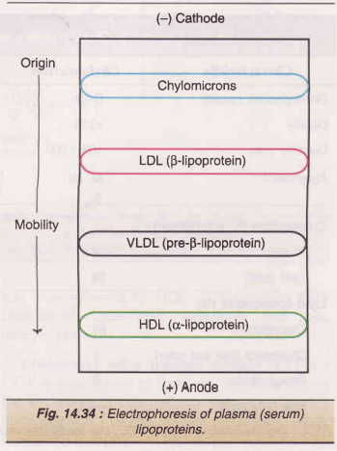
Classification of lipoproteins
1. Chylomicrons : They are synthesized in the intestine
2. Very low density lipoproteins (VLDL) : They are produced in liver and intestine.
3. Low density lipoproteins (LDL) : They are formed from VLDL in the blood circulation.
4.High density lipoproteins (HDL) : They are mostly synthesized in liver
5. Free fatty acids-albumin : Free fatty acids in the circulation are in a bound form to albumin

Slide 64
Apolipoproteins
The protein components of lipoproteins are known as apolipoproteins or, simply, apoproteins. They perform the following functions
1 . Act as structural components of lipoproteins.
2. Recognize the cell membrane surface receptors.
3. Activate enzymes involved in lipoprotein metabolism

Slide 65
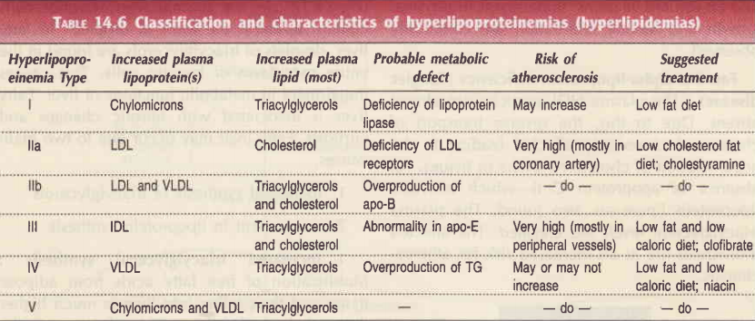
Hyperlipoproteinemia

Slide 66
Atherosclerosis
Atherosclerosis (Greek: athere-mush) is a complex disease characterized by thickening or hardening of arteries due to the accumulation of lipids (particularly cholesterol, free, and esterified) collagen, fibrous tissue, proteoglycans, calcium deposits etc. in the inner arterial wall.
Atherosclerosis is a progressive disorder that narrows and ultimately blocks the arteries.
lnfarction is the term used to indicate the stoppage of blood flow resulting in the death of affected tissue.
Coronary arteries--the arteries supplying blood to heart-are the most commonly affected leading to myocardial infarction or heart attacks.

Slide 67


